Slide 1
MathCore Automatic Scoring Program
1조 ProPEER
김경욱 김시훈
박형영 정채린
Notes:
Good afternoon, everyone. We are Team ProPEER.
We are going to present about Mathcore.
This is the android application that can score automatically mathematics workbooks.

Slide 2
Contents
Team Member
Main Subject
Development Background & Target
Development Schedule
Differentiation and Benefit
System Flow
Module-specific Features
AI Technology
Benefit and Scalability
Notes:
This is our presentation contents.

Slide 3
Team Member & GitHub Link
Member | Role | GitHub
박형영 | Team Leader Machine Learning Model Developer | https://github.com/Park-HY-00
김경욱 | Application Main Developer : End to End | https://github.com/kgu011016
김시훈 | Application Main Developer: End to End | https://github.com/Mistyclawn
정채린 | Application Main Designer Application Developer | https://github.com/chaerin-77
GitHub of Team | https://github.com/ProPEER-CBNU/mathcore_android
Notes:
And this is our team member and roles.
(// 팀 멤버의 롤 간단히 소개)
형영 is leader of our team. She is a machine learning model developer.
경욱 and 시훈 is an application main developer. They participated in both frontend and backend.
채린 is an application main designer. She directed design of an application and participated development.
You can check up our development progress through this github link.

Slide 4
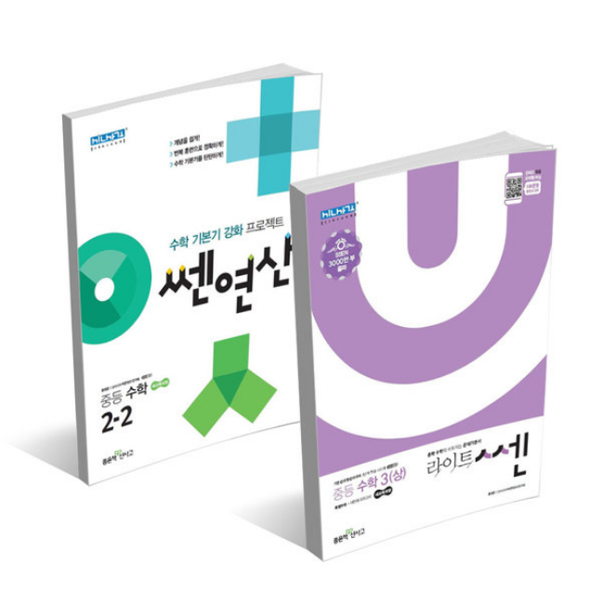
Main Subject
Automatic Scoring Program
for mathematics workbook
via Handwriting Recognition
Notes:
Main Subject is Automatic Scoring Program for mathematics workbook via Handwriting Recognition.

Slide 5
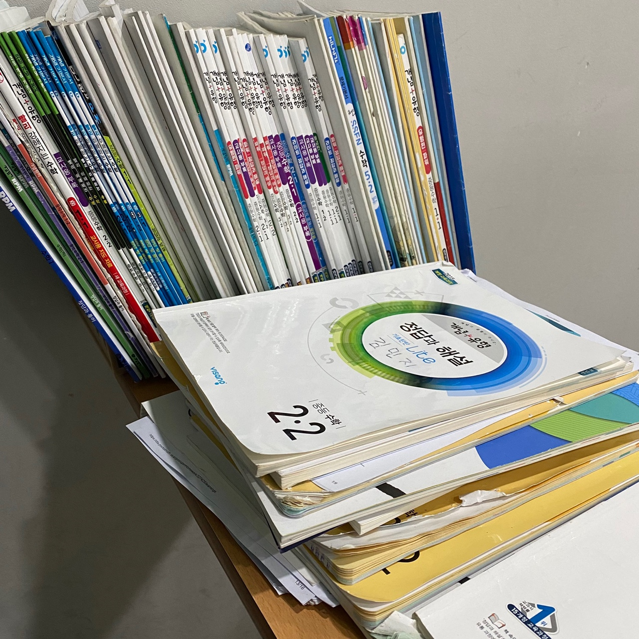
Background of Development
Scoring Job in mathematics academy
Bothering
Take too much time
Application Trend
AI + Education
Notes:
In mathematics academy, scoring job is very bothering and takes too much time.
And recent application market trend is Education with AI technology.

Slide 6
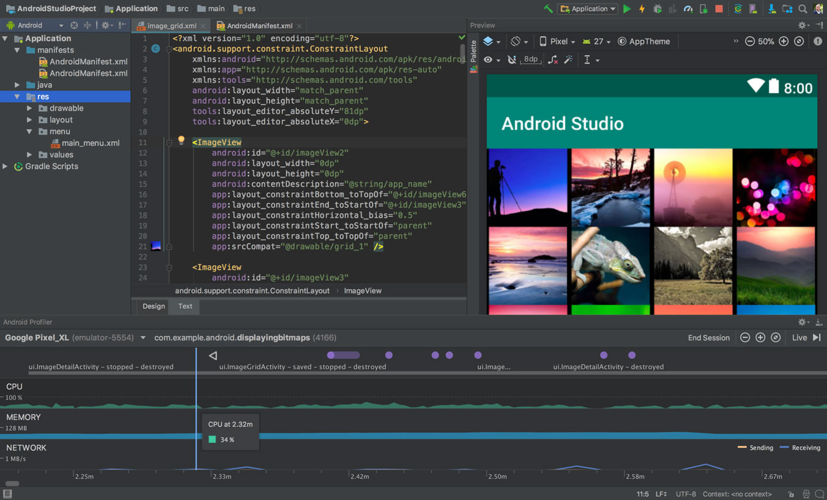
Development Target
Android Application
Tool: Android Studio
Programming Language: Java
Recognition Module
Tool: Python 3.6
Pytorch with CUDA
Version Management GitHub
Image Source: https://developer.android.com/studio
Notes:
So, we decided to develop this application.
The main tool is Android Studio and programming language is Java.
The handwritten recognition module is built by Python and Pytorch.
And we are managing the version of program with GitHub.

Slide 7
Development Schedule
Schedule | 2022.04.01 ~ 2022.06.10
Steps | April |  |  |  | May |  |  |  | June
 | 4~10 | 11~17 | 18~24 | 25~1 | 2~8 | 9~15 | 16~22 | 23~29 | 30~5
Project Name
Blueprint
Screen Design
Function Manual
Algorithm Design
Implementation
Presentation Material
Presentation
Report Writing
Notes:
This is the development schedule from April and June.

Slide 8
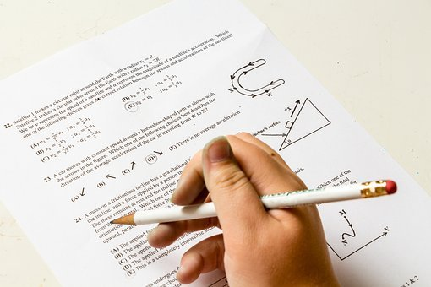
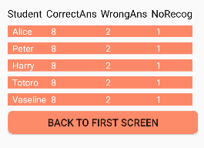
Differentiation and Benefit
Fast Auto Scoring
Easy to manage the Score data
Notes:
The first differentiation is “Fast Auto Scoring”.
The second differentiation is “Easy to manage the students’ score data”.

Slide 9
System Flow
Sign Up
Sign In
Input “Workbook Image”
Select Workbook
Scoring
Output “Score”
Show “Score Data List”
Notes:
This is diagram of system flow.
First, sign up and sign in.
Second, if user wants to scoring the workbook, input the workbook image.
Third, select the workbook’s title.
And than, the program will score the workbooks automatically.
Finally, score data will be show up.
User can see the score data anytime.

Slide 10

Module-Specific Features
AI in Handwritten Recognition Module
Processing Modules in Application
Notes:
From now on, I’ll explain about module-specific features.
There are two parts, AI in Handwritten Recognition Module, and basic processing modules for users in application.

Slide 11
AI in Handwritten Recognition Module
Image Loading
Binarization
Labelling
Recognition
Output Result
File
Open/Close
Scailing
Classification
Flow-chart of Handwritten Math Formula Recognition Module
Notes:
The main AI technology of our project is Handwritten Math Formula Recognition.

Slide 12
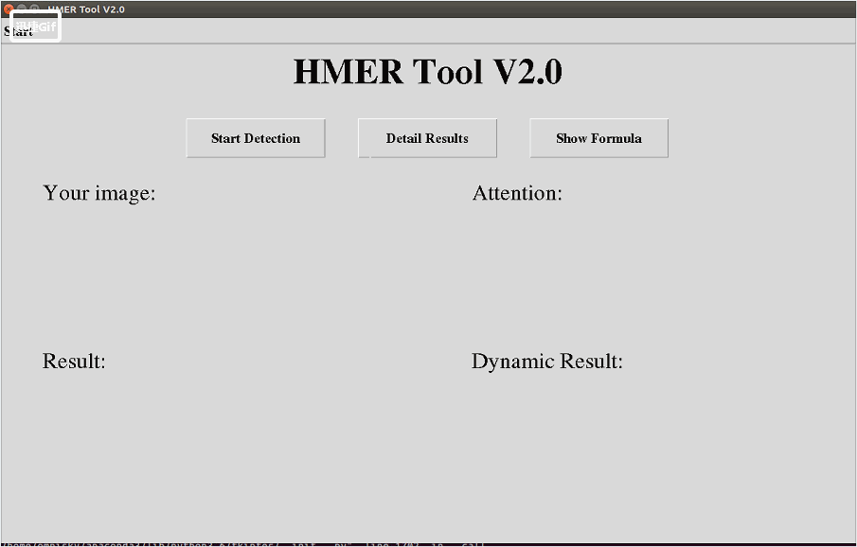
AI in Handwritten Recognition Module
Using Open API from GitHub (MIT License)
https://github.com/whywhs/Pytorch-Handwritten-Mathematical-Expression-Recognition
Notes:
Making deep learning model all by myself is too difficult.
So, I used Open API from GitHub which has MIT License.
If user input the math formula image, the program recognize each element one by one.
And user can see result that is organized formula.

Slide 13
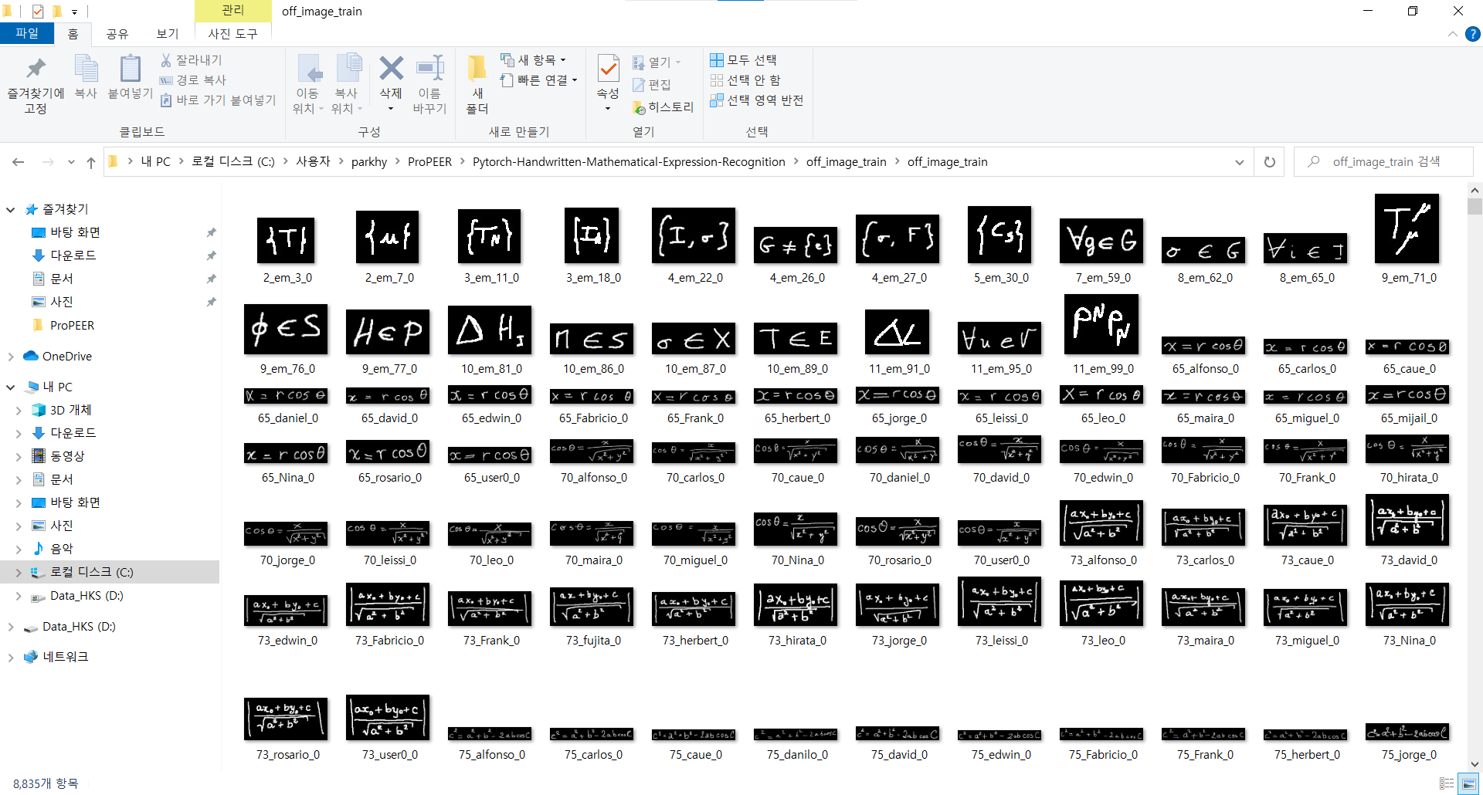
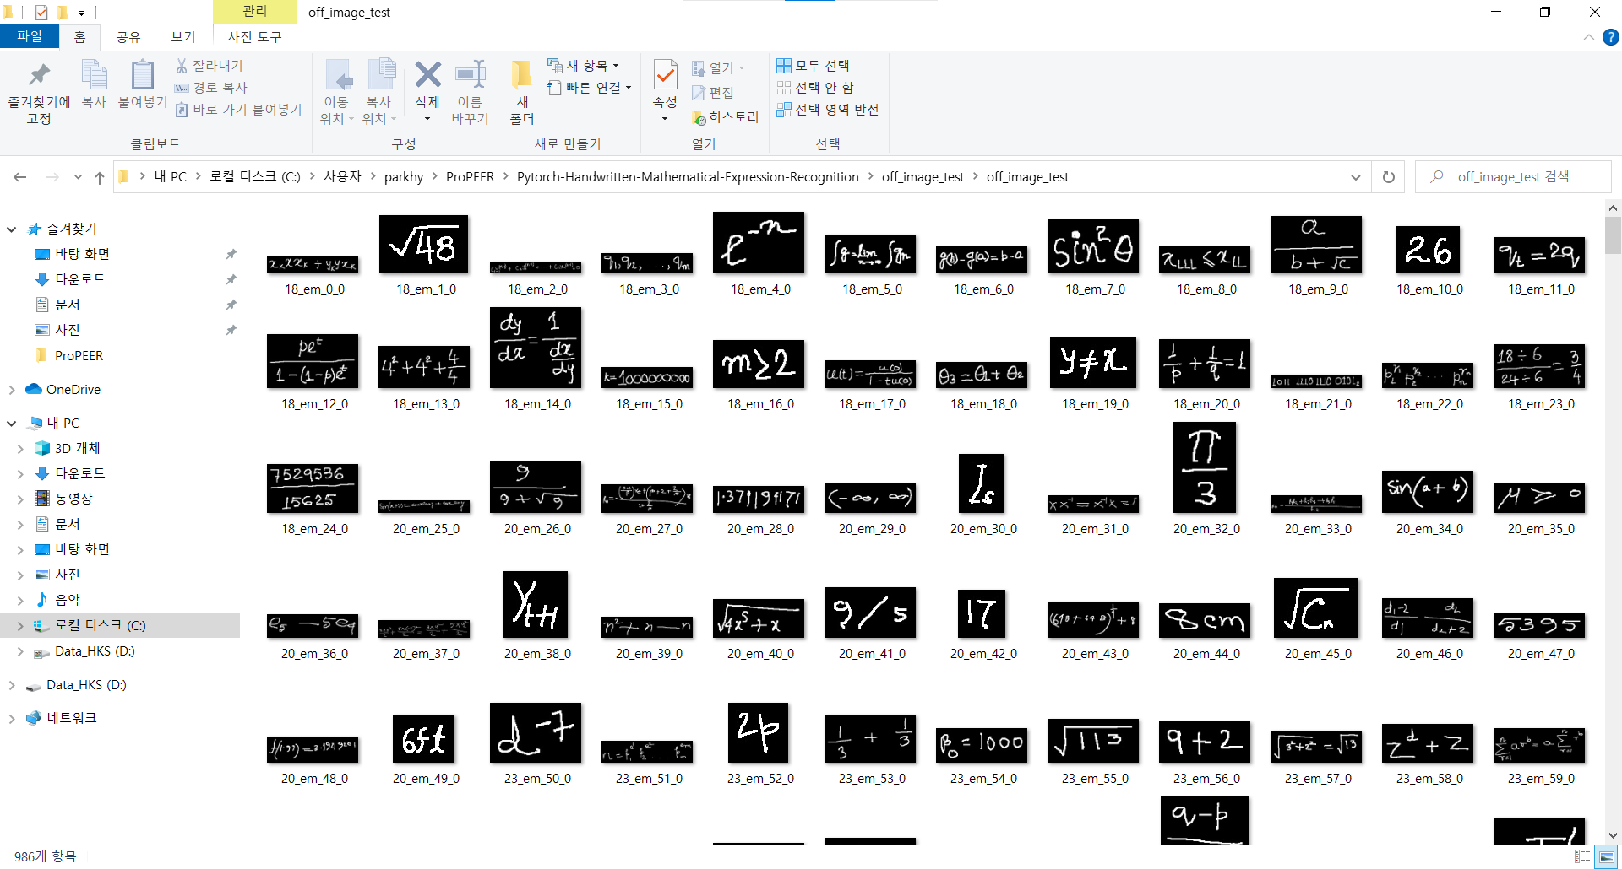
Data Set for Deep Learning Model
Train Set: 8835 images
Test Set: 986 images
Notes:
These are handwritten math formula images in train set and test set.
This API binarizes these images and then trains the deep learning model with these files.

Slide 14
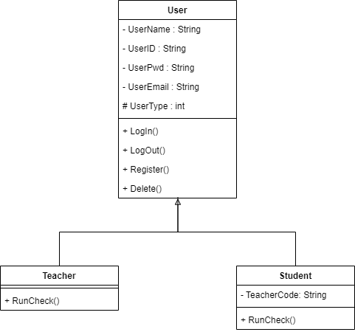
User
“Student” can be managed by “Teacher”
Notes:
I’ll show simple class diagram to explain the module in this program.
There are two User type, Teacher and Student.
Teacher can manage students and student’s score data.

Slide 15
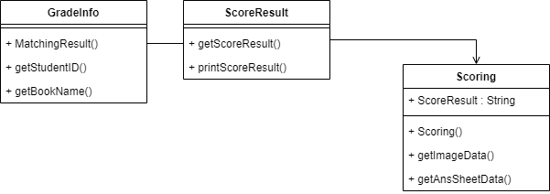
Grade
Handwritten Recognition Module in “Scoring”
Notes:
This class diagram show a grading and scoring process briefly.
Handwritten recognition module will be in “Scoring” class.

Slide 16
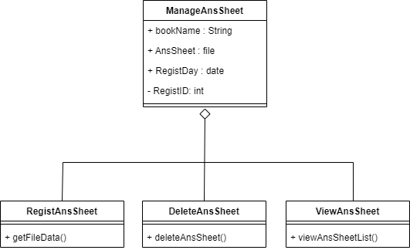
Answer Sheet
To manage various Answer Sheets.
Notes:
We made this module so that User can manage various answer sheets.
User can register, delete and view the Answer Sheet.

Slide 17

Demonstration Video
https://youtu.be/WTEfRopQMGA
Notes:
I’ll show you a demonstration video.
The handwritten recognition model isn’t in this application yet.
We tried to make easy UX/UI.

Slide 18




Scalability
Add the Subject
(English, Korean, etc)
Provide supplement materials
by Big Data
Scoring Narrative Answer
by NLP
Notes:
We have 3 scalabilities.
First, add the subject that can be scored. To do this, we need to extend the range of handwriting recognition.
Second, provide supplement materials by big data. It can be helped for self-study.
Third, score the narrative answer by natural language process.

Slide 19
Thank You!
Any Question?
Notes:
Thank you for listening the presentation.
If you have any question, you can ask from now on.

